Slide 1
THE PONG GAME
REVIEW-1
T. TEJAS – 18BEC0396
K. AKSHAR – 18BEC0863

Slide 2
OBJECTIVES
To successfully build a working Pong game using only Assembly language for all parts of the game, including graphics rendering, game logic and timing.
To understand the working of the x86 emulator (DOSBOX) and use it to assemble and execute the pong.asm game source code.
To understand the various Interrupts used for calling different services/handlers for various tasks like setting the video mode for graphics, measuring time, I/O operations etc.

Slide 3
PROJECT SPECIFICATIONS
Software Specifications
Emulator: DOSBOX (A program to emulate an IBM PC running a DOS Operating System. Here, in this case, it is used to emulate an 8086 microprocessor.)
Assembler: MASM (Microsoft Macro Assembler)
Text Editor: Notepad++ (or any other adequate text editor)
Hardware Specifications:
Just a Keyboard for key input.

Slide 4
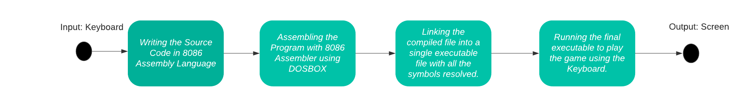
PROPOSED SYSTEM FLOW

Slide 5
TECHNICAL DETAILS
We are not using a Microcontroller. This is purely a software project realised using the 8086 Microprocessor, written entirely in Assembly Language. If provided the resources, this can easily be implemented on hardware.
We will use three Interrupts in the x86 instruction set (10H, 16H & 21H), and AH and AL 8 bit registers to call various services through these interrupts.
INT 10H provides video services. The values of AH and AL together are used for calling specific functions like setting the video mode, choosing colour output etc. We use it for graphics rendering.
INT 16H provides I/O operation services. It helps in updating output based on keyboard inputs.
INT 21H provides system time information. We use it as the basis for screen refresh at a 100 fps. More the fps, smoother the graphical transitions.

Slide 6
PROCESS
Creating a blank screen.
Drawing a pixel on the blank screen using Interrupt 10H.
Drawing a ball by accumulating multiple pixels.
Moving the ball by assigning a preset 2-D velocity.
Refreshing the Screen at 100FPS with the updated position of the ball.
Creating two Paddles,and enabling them to move in the Y axis based on the Keyboard input.
Collision Detection between the ball and the paddle by using the Axis Aligned Bounding Boxes Collision Model.

Slide 7
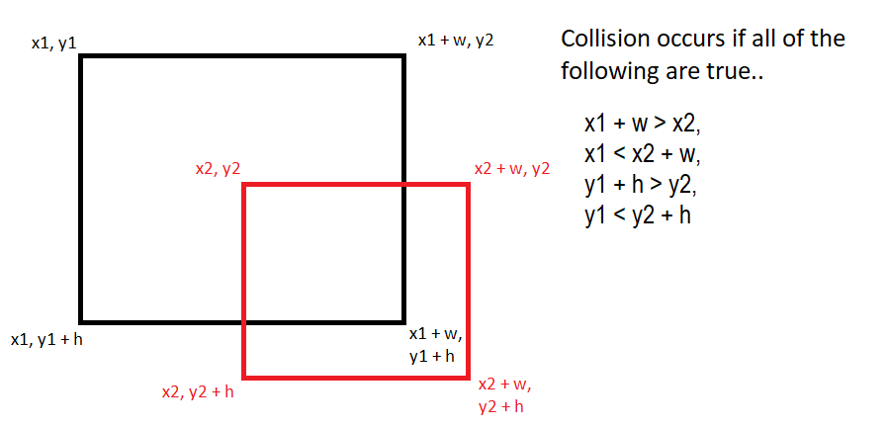
AABB (Axis Aligned Bounding Boxes) Collision Detection Model

Slide 8
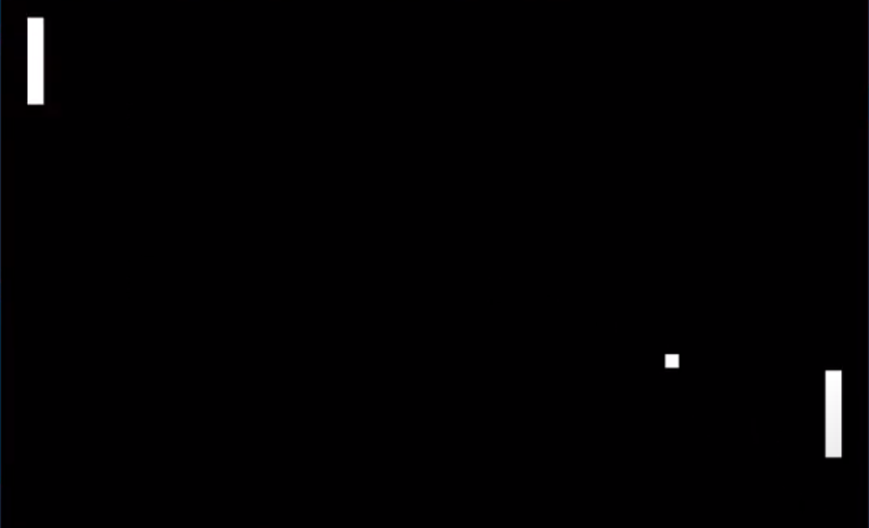
OUTPUT
The output is the paddle response in the game depending on the keyboard inputs provided by the user.
Two keys each are used to operate the left and right paddle.

